Slide 1
EXPRESSIONS

Slide 2
EXPRESSION
An expression is an instruction that combines values and operators and always evaluates down to a single value.
For example, this is an expression:
>>> 2 + 2
>>> 4
2s are integer values and the + is the mathematical operator. This expression evaluates down to the single integer value 4.

Slide 3
EXPRESSION
x = 0.6
A variable is a memory location used to store a value (0.6).
0.6
0.6
x = 3.9 * x * ( 1 - x )
0.4
Right side is an expression. Once the expression is evaluated, then its result is placed in (assigned to) x.
0.93

Slide 4

EXPRESSION
A variable is a memory location used to store a value. The value stored in a variable can be updated by replacing the old value (0.6) with a new value (0.93).
x = 3.9 * x * ( 1 - x )
Right side is an expression. Once expression is evaluated, the result is placed in (assigned to) the variable on the left side (i.e. x).
0.93

Slide 5
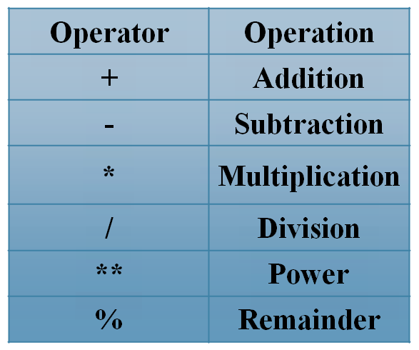
NUMERIC EXPRESSIONS
>>> xx = 2
>>> xx = xx + 2
>>> print xx
4
>>> yy = 440 * 12
>>> print yy
5280
>>> zz = yy / 1000
>>> print zz
5
>>> jj = 23
>>> kk = jj % 5
>>> print kk
3
>>> print 4 ** 3
64

Slide 6
ORDER OF EVALUATION
When we string operators together - Python must know which one to do first, this is called “operator precedence”.
Which operator “takes precedence” over the others.
x = 1 + 2 * 3 - 4 / 5 ** 6

Slide 7
OPERATOR PRECEDENCE RULES
Highest precedence rule to lowest precedence rule.
Parenthesis are always respected.
Exponentiation (raise to a power).
Multiplication, Division, and Remainder.
Addition and Subtraction.
Left to right.
Parenthesis
Power
Multiplication
Addition
Left to Right

Slide 8
OPERATOR PRECEDENCE EXAMPLE
1 + 2 ** 3 / 4 * 5
>>> x = 1 + 2 ** 3 / 4 * 5
>>> print x
11
1 + 8 / 4 * 5
1 + 2 * 5
Parenthesis
Power
Multiplication
Addition
Left to Right
1 + 10
11

Slide 9
OPERATOR PRECEDENCE EXAMPLE
>>> x = 1 + 2 ** 3 / 4 * 5
>>> print x
11
1 + 2 ** 3 / 4 * 5
1 + 8 / 4 * 5
Note:
8/4 goes before 4*5 because of the left-right rule.
1 + 2 * 5
Parenthesis
Power
Multiplication
Addition
Left to Right
1 + 10
11

Slide 10
EXPRESSION EXAMPLE
>>> a=5
>>> b=10
>>> c=3
>>> d=2
>>> e=1
>>> f=9
>>> x=(a+b)
>>> print(x)
15
>>> x=(a+b)*(c*d)/e-f
>>> print(x)
81.0

Slide 11
OPERATOR PRECEDENCE
Remember the rules top to bottom.
When writing code - use parenthesis.
When writing code - keep mathematical expressions simple enough that they are easy to understand.
Break long series of mathematical operations up to make them more clear.
x = 1 + 2 * 3 - 4 / 5
x = ?

Slide 12
TYPE CASTING

Slide 13
TYPE CASTING / TYPE CONVERSION
When you put an integer and floating point in an expression the integer is implicitly converted to a float.
You can control this with the built in functions int() and float().
>>> print (float(99) / 100)
0.99
>>> i = 42
>>> type(i)
<type 'int'>
>>> f = float(i)
>>> print f
42.0
>>> type(f)
<type 'float'>
>>> print (1 + 2 * float(3) / 4 – 5)
-2.5

Slide 14
TYPE CASTING / TYPE CONVERSION
You can also use int() and float() to convert between strings and integers.
You will get an error if the string does not contain numeric characters.
String Conversions:

Slide 15
TYPE CASTING / TYPE CONVERSION
>>> sval = '123'
>>> type(sval)
<type 'str'>
>>> print (sval + 1)
Traceback (most recent call last):
File "<stdin>", line 1, in <module>
TypeError: cannot concatenate 'str' and 'int'
>>> ival = int(sval)
>>> type(ival)
<type 'int’>
>>> print ival + 1
124
>>> nsv = 'hello'
>>> niv = int(nsv)
Traceback (most recent call last):
File "<stdin>", line 1, in <module>
ValueError: invalid literal for int()

Slide 16
TYPE CASTING / TYPE CONVERSION
>>> number = int(input("Enter a number: "))
Enter a number: 3
>>> number
3
>>>
An integer
(no single quotes)!

Slide 17
TYPE CASTING / TYPE CONVERSION
>>> number = float(input("Enter a number: "))
Enter a number: 3.7
>>> number
3.7
>>>
Float
(no single quotes)!

Slide 18
TYPE CASTING / TYPE CONVERSION
>>> x = 10
>>> float(x)
10.0
>>> str(x)
'10'
>>>
>>> y = "20"
>>> float(y)
20.0
>>> int(y)
20
>>>
>>> z = 30.0
>>> int(z)
30
>>> str(z)
'30.0'
>>>
integer ➔ float
integer ➔ string
string ➔ float
string ➔ integer
float ➔ integer
float ➔ string

Slide 19
TYPE CASTING / TYPE CONVERSION
>>> print(2 + 3.4)
5.4
>>> print( 2 + 3)
5
>>> print(9/5 * 27 + 32)
80.6
>>> print(9//5 * 27 + 32)
59
>>> print(5.9 + 4.2)
10.100000000000001
>>>
The result of an expression that involves
a float number alongside (an) integer
number(s) is a float number.

Slide 20
TYPE CASTING / TYPE CONVERSION
>>> print(2 + 3.4)
5.4
>>> print( 2 + 3)
5
>>> print(9/5 * 27 + 32)
80.6
>>> print(9//5 * 27 + 32)
59
>>> print(5.9 + 4.2)
10.100000000000001
>>>
The result of an expression that involves
a float number alongside (an) integer
number(s) is a float number
The result of an expression that involves
values of the same data type will not result
in any conversion.

Slide 21
STANDARD LIBRARY MODULES
(MATH, STATISTICS, RANDOM)

Slide 22
STANDARD LIBRARY MODULES
The Python Standard Library is a collection of script modules accessible to a Python program to simplify the programming process and removing the need to rewrite commonly used commands.
They can be used by 'calling / importing' them at the beginning of a script.
The following are among the most important:
    time
    sys
    math
    statistics
    random
    socket

Slide 23
MATH – STANDARD LIBRARY
The math module gives access to C library functions for floating point math.
>>> import math
>>> math.cos(math.pi / 4.0)
0.70710678118654757
>>> math.log(1024, 2)
10.0

Slide 24
STATISTICS – STANDARD LIBRARY
The statistics module calculates basic statistical properties (the mean, median, variance, etc.) of numeric data:
>>> import statistics
>>> data=[1.5, 2.5,55.85,442.365,78.0]
>>> statistics.mean(data)
116.043
>>> statistics.median(data)
55.85
>>> statistics.variance(data)
34392.15662

Slide 25
RANDOM – STANDARD LIBRARY
The random module provides tools for making random selections:
>>> import random
>>> random.choice(['a','d','b','l','k','h','e'])
'd '
>>> random.sample(range(100), 10)
[90, 95, 70, 18, 82, 88, 45, 53, 63, 8]
>>> random.random()
0.7279867204454846
>>> random.randrange(6)
5

